Slide 1
Implement Map reduce
operation with suitable
example using MongoDB

Slide 2
MapReduce
Introduction to MapReduce
How MapReduce Works?
MapReduce Syntax
MapReduce Examples
Map-Reduce function usage

Slide 3
Map-Reduce
MapReduce is a programming model for writing applications that can process Big Data in parallel on multiple nodes.
MapReduce provides analytical capabilities for analyzing huge volumes of complex data.
MapReduce divides a task into small parts and assigns them to many computers. Later, the results are collected at one place and integrated to form the result dataset.

Slide 4
How MapReduce Works?
The MapReduce algorithm contains two important tasks, namely Map and Reduce.
The Map task takes a set of data and converts it into another set of data, where individual elements are broken down into tuples (key-value pairs).
The Reduce task takes the output from the Map as an input and combines those data tuples (key-value pairs) into a smaller set of tuples.
The reduce task is always performed after the map job.

Slide 5
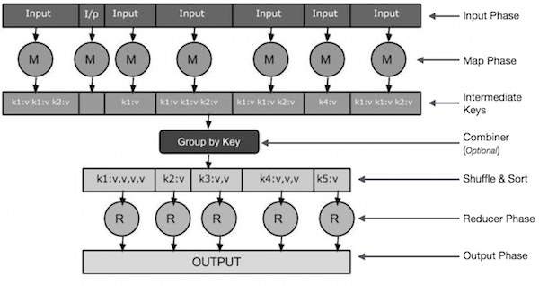
How MapReduce Works?

Slide 6
Map-Reduce Syntax
Map Reduce, use mapReduce() function for performing aggregation operations on a MongoDB Collection
Following is the syntax of mapReduce() function that could be used in Mongo Shell
>db.collection.mapReduce(
function() {emit(key,value);}, // map function
function(key,values) {return reduceFunction}, // reduce function
{ out: collection, query: document, sort: document,limit: number }
)

Slide 7
Map-Reduce Syntax Exaplanation
map-reduce function will query the collection, and then map the output documents to the emit key-value pairs. After this, it is reduced based on the keys that have multiple values. Here, we have used the following functions and parameters.
Map: – It is a JavaScript function. It is used to map a value with a key and produces a key-value pair.
Reduce: – It is a JavaScript function. It is used to reduce or group together all the documents which have the same key.
Out: – It is used to specify the location of the map-reduce query output.
Query: – It is used to specify the optional selection criteria for selecting documents.
Sort: – It is used to specify the optional sort criteria.
Limit: – It is used to specify the optional maximum number of documents which are desired to be returned.

Slide 8
Example for MongoDB mapReduce()
In this example , students is a collection and the collection has documents where each document has name of the student, marks he/she scored in a particular subject.
We shall apply mapReduce function to accumulate(aggregated) the marks for each student.
> db.students.find({}); { "_id" : 1, "name" : "Midhu", "subject" : "science", "marks" : 68 } { "_id" : 2, "name" : "Midhu", "subject" : "maths", "marks" : 98 } { "_id" : 3, "name" : "Midhu", "subject" : "sports", "marks" : 77 } { "_id" : 4, "name" : "Akhil", "subject" : "science", "marks" : 67 } { "_id" : 5, "name" : "Akhil", "subject" : "maths", "marks" : 87 } { "_id" : 6, "name" : "Akhil", "subject" : "sports", "marks" : 89 } { "_id" : 7, "name" : "Anish", "subject" : "science", "marks" : 67 } { "_id" : 8, "name" : "Anish", "subject" : "maths", "marks" : 78 } { "_id" : 9, "name" : "Anish", "subject" : "sports", "marks" : 90 }

Slide 9
Following is a step by step guide to prepare mapReduce function for the use case in Mongo Shell :
Step 1- Prepare Map function. Our map function should emit key-value pair. And in this case, name is key and value is marks.
Step 2- Prepare Reduce function. Our map function should emit key-value pair. And in this case, name is key and value is marks.
Step 3- Prepare mapReduce function. Our map function should emit key-value pair. And in this case, name is key and value is marks.
out: "totals" : the output is written to totals collection in the same database.
var map = function() {emit(this.name,this.marks);};
var map = function() {emit(this.name,this.marks);};
var map = function() {emit(this.name,this.marks);};
var reduce = function(name,marks) {return Array.sum(marks);};
db.students.mapReduce(map, reduce, { out : "totals" } );

Slide 10
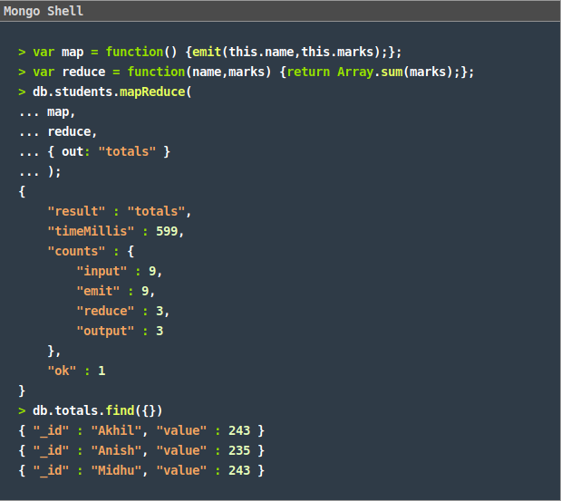
Step 4- Run mapReduce. Start a Mongo Shell and Run the above commands (in Step 1 to Step 3) in Mongo Shell.

Slide 11
Example 2 for MongoDB mapReduce()
Consider the following document structure that stores book details author wise. The document stores author_name of the book author and the status of book. Now, use the mapReduce function ,To select all the active books, group them together on the basis of author_name and then count the number of books by each author.
> db.author.find()
{ "_id" : 1, "book_title" : "MongoDB Tutorial","author_name" : "aparajita", "status" : "active", "publish_year" : "2016" }
{ "_id" : 2, "book_title" : "Software Testing Tutorial", "author_name" : "aparajita", "status" : "active", "publish_year" : "2015" }
{ "_id" : 3, "book_title" : "Node.js Tutorial","author_name" : "aparajita", "status" : "active", "publish_year" : "2016" }
{ "_id" : 4, "book_title" : "PHP7 Tutorial","author_name" : "aparajita", "status" : "active", "publish_year" : "2016" }

Slide 12
Following is a step by step guide to prepare mapReduce function for the use case in Mongo Shell :
Step 1- Prepare Map function. Our map function should emit key-value pair. And in this case, name is key and value is marks.
Step 2- Prepare Reduce function. Our map function should emit key-value pair. And in this case, name is key and value is marks.
Step 3- Prepare mapReduce function. Our map function should emit key-value pair. And in this case, name is key and value is marks.
out: "author_totals" : the output is written to author_totals collection.
var map = function() {emit(this.author_name,1);};
var reduce = function(key,values) {return Array.sum(values);};
db.author.mapReduce(map, reduce, { query:{status:"active"},out : "author_totals" } );

Slide 13
Step 4- Run mapReduce. Start a Mongo Shell and Run the above commands (in Step 1 to Step 3) in Mongo Shell.
Step 5: Output.
{ "_id" : "aparajita", "value" : 2 }
{ "_id" : “Kritika", "value" : 1 }

Slide 14
Example 3 for MongoDB mapReduce()
Consider the following document structure of Students.
> db.stud.insert({ Name: ‘Amit’, Marks:80 })
>db.stud.insert({ Name: ‘Amit’, Marks:90 })
>db.stud.insert({ Name: ‘Shreya’, Marks:40 })
>db.stud.insert({ Name: ‘Nitin’, Marks:80 })
>db.stud.insert({ Name: ‘Nitin’, Marks:35})

Slide 15
Ex 1- mapReduce function.
Ex 2- mapReduce function.
Ex 3- mapReduce function..
> db.stud.mapReduce(
function(){ emit(this.Name,1)},
function(key, values) {return Array.sum(values)},
{out: “Name_Total“ })
> db.stud.mapReduce(
function(){ emit(this.Name,1)},
function(key, values) {return Array.sum(values)},
{out: “Name_Total“ }).find()
> db.stud.mapReduce(
function(){ emit(this.Name,this.Marks)},
function(key, values) {return Array.sum(values)},
{out: “Name_Total“ }).find()

Slide 16
Ex 4- mapReduce function.
Ex 5- mapReduce function.
Ex 6- mapReduce function..
> db.stud.mapReduce(
function(){ emit(this.Name,,this.Marks)},
function(key, values) {return Array.sum(values)},
{out: “Name_Total“ }).find().sort({value:1})
> db.stud.mapReduce(
function(){ emit(this.Name,,this.Marks)},
function(key, values) {return Array.sum(values)},
{out: “Name_Total“ }).find().limit(1)
> db.stud.mapReduce(
function(){ emit(this.Name,1)},
function(key, values) {return Array.sum(values)},
{query:{Marks:{$gt:70}},out: 'Name_Total'}).find()

Slide 17
Map-Reduce function usage in the industry:
1) Google:
– Index building for Google Search
– Article clustering for Google News
– Statistical machine translation
2) At Yahoo!:
– Index building for Yahoo! Search
– Spam detection for Yahoo! Mail
3) At Facebook:
– Data mining
– Ad optimization
– Spam detection Example
4) At Amazon:
– Product clustering
– Statistical machine translation

Slide 18
References
https://docs.mongodb.com/manual

